Slide 1



Adversarially Robust Submodular Maximization under Knapsack Constraints
DMITRII AVDIUKHIN
SLOBODAN MITROVIĆ
GRIGORY YAROSLAVTSEV
SAMSON ZHOU

Slide 2





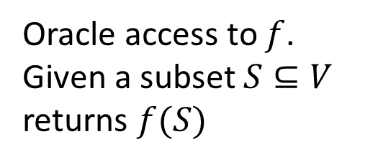

Submodular Functions
Ground Set $V$ (items, sets, vertices)
Set function $f:2^{V}→ℝ$ with diminishing returns property
Oracle access to $f$.
Given a subset $S⊆V$
returns $f(S)$
$$∀ A⊆B⊆V, e∉B$$
$$f\left(A∪\left\{e\right\}\right)−f(A)$$
$$≥$$
$$f\left(B∪\left\{e\right\}\right)−f(B)$$

Slide 3
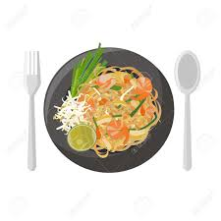
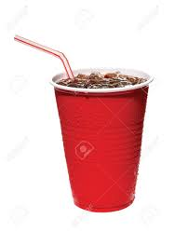


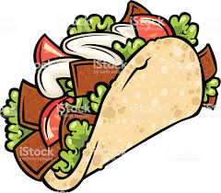





Submodular Functions
$V=$ $\{ \}$
$$A$$
$$B$$
$$f\left(A∪\left\{e\right\}\right)−f(A)$$
$$≥$$
$$f\left(B∪\left\{e\right\}\right)−f(B)$$

Slide 4
Applications of Submodular Functions
Viral marketing [Kempe et al., 2003]
Feature selection [Krause & Guestrin, 2005]
Clustering [Narasimhan & Bilmes, 2005]
Search result diversification [Agrawal et al., 2009]
Recommender systems [El-Arini & Guestrin, 2011]
Active learning [Golovin & Krause, 2011]
Document summarization [Lin & Bilmes, 2011]
Data subset selection [Wei, Iyer & Bilmes, 2015]
etc

Slide 5
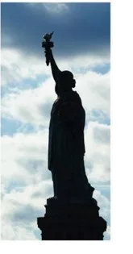
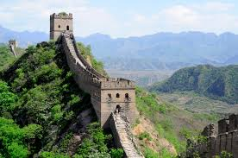
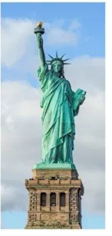
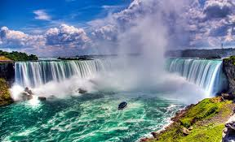
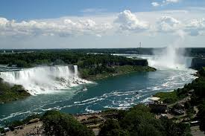
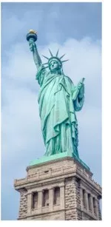
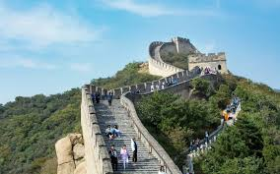
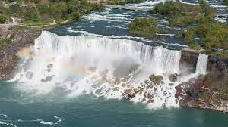
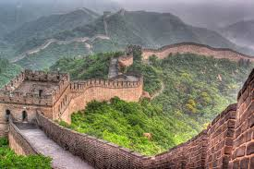
Clustering

Slide 6

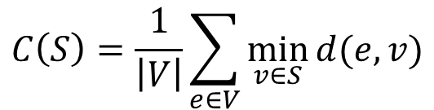
Clustering
$$C\left(S\right)=\frac{1}{\left|V\right|}\sum_{e∈V}{\min_{v∈S}{d(e,v)}}$$
$$f\left(S\right)=C\left(\{e_{0}\}\right)−C(S∪\left\{e_{o}\right\})$$

Slide 7

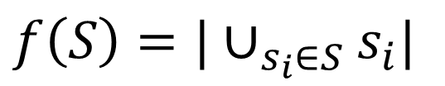

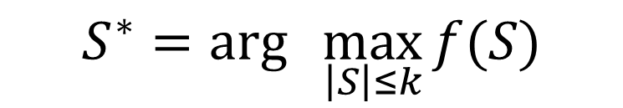
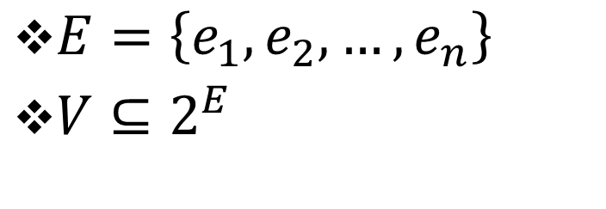

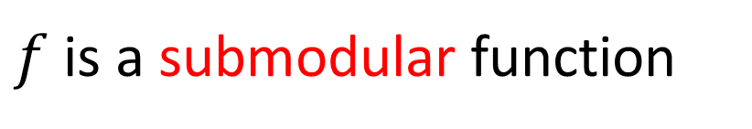
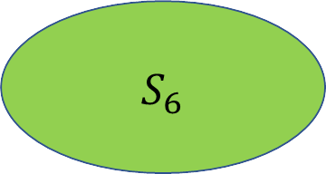
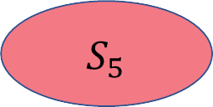
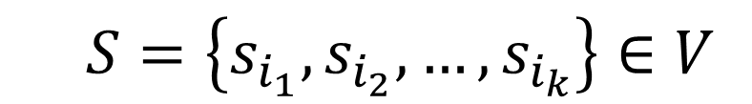

Coverage
$E=\left\{e_{1},e_{2},…,e_{n}\right\}$
${V⊆2}^{E}$
$$S=\left\{s_{i_{1}},s_{i_{2}},…,s_{i_{k}}\right\}∈V$$
$f\left(S\right)=|∪_{s_{i}∈S}s_{i}|$
$f$ is a submodular function
$S_{6}$
$S_{3}$
$S_{2}$
$S_{1}$
$$S^{∗}=arg\max_{ \left|S\right|≤k}{f(S)}$$
$S_{5}$
$S_{4}$

Slide 8












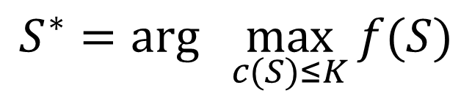
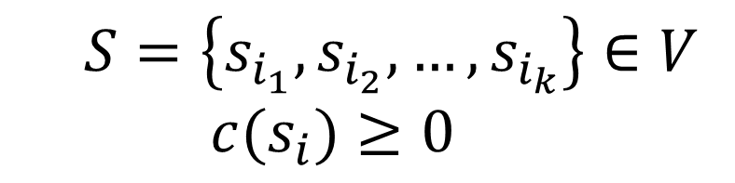
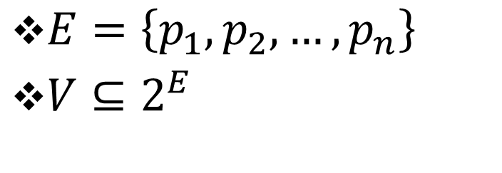
Viral Marketing
$$S^{∗}=arg\max_{ c(S)≤K}{f(S)}$$
$E=\left\{p_{1},p_{2},…,p_{n}\right\}$
${V⊆2}^{E}$
$$S=\left\{s_{i_{1}},s_{i_{2}},…,s_{i_{k}}\right\}∈V$$
$${c(s}_{i})≥0$$

Slide 9
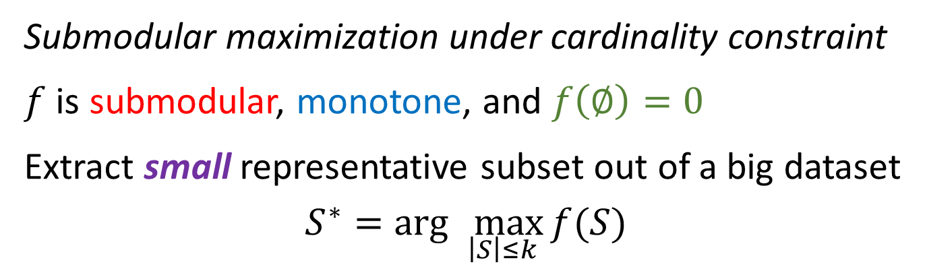
First Objective
Submodular maximization under cardinality constraint
$f$ is submodular, monotone, and $f\left(∅\right)=0$
Extract small representative subset out of a big dataset
$$S^{∗}=arg\max_{ \left|S\right|≤k}{f(S)}$$
Solving this problem exactly is NP-hard

Slide 10
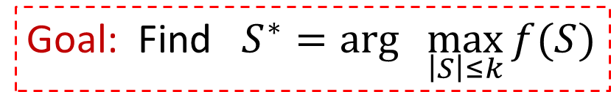
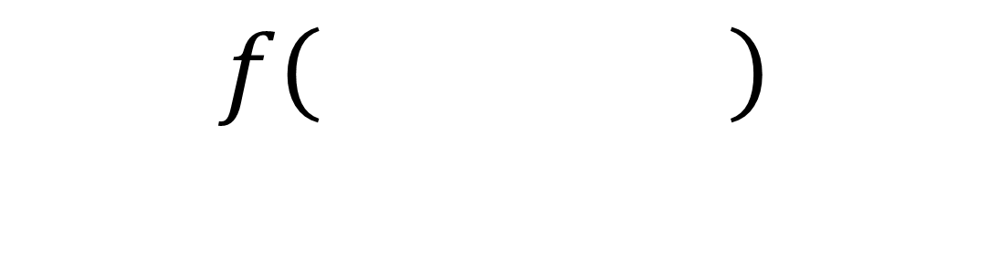
Greedy [Nemhauser, Wolsey, Fisher, ‘78]
$V=$ $\{ \}$
Marginal gain:
Goal: Find $S^{∗}=arg\max_{ \left|S\right|≤k}{f(S)}$
$$f\left( \right)$$

Slide 11


Greedy [Nemhauser, Wolsey, Fisher, ‘78]
$V=$ $\{ \}$
Marginal gain:
Goal: Find $S^{∗}=arg\max_{ \left|S\right|≤k}{f(S)}$
$$f\left( \right)$$
$$≥\left(1−1/e\right)OPT$$

Slide 12




Traditional
Modern
streaming
…
…
Algorithms performed sequentially.

Slide 13
Traditional
Modern
distributed
Algorithms performed sequentially.

Slide 14
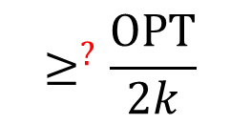
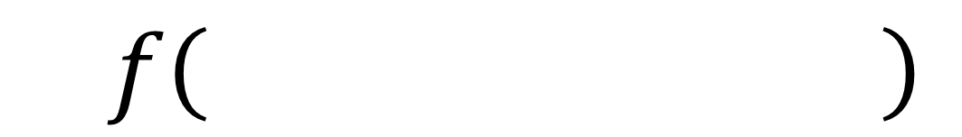
Thresholding [Badanidiyuru, Mirzasoleiman, Karbasi, Krause, ‘14]
Stream:$\}$
$$≥^{?}\frac{OPT}{2k}$$
$$f\left( \right)$$

Slide 15

Thresholding [Badanidiyuru, Mirzasoleiman, Karbasi, Krause, ‘14]
Stream:$\}$
$$≥^{?}\frac{OPT}{2k}$$
$$f\left( \right)$$

Slide 16

Thresholding [Badanidiyuru, Mirzasoleiman, Karbasi, Krause, ‘14]
Stream:$\}$
$$≥^{?}\frac{OPT}{2k}$$
$$f\left( \right)$$

Slide 17

Thresholding [Badanidiyuru, Mirzasoleiman, Karbasi, Krause, ‘14]
Stream:
$$≥^{?}\frac{OPT}{2k}$$
$$f\left( \right)$$

Slide 18
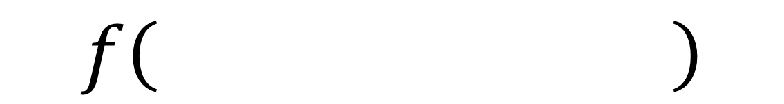

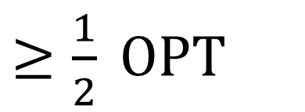
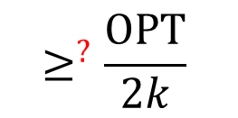
Thresholding [Badanidiyuru, Mirzasoleiman, Karbasi, Krause, ‘14]
Stream:
$$≥^{?}\frac{OPT}{2k}$$
$OPT∈\{{\left(1+ε\right)}^{i}|i∈N\}$
$$f\left( \right)$$
$≥\frac{1}{2} OPT$

Slide 19

Second Objective
Submodular maximization under knapsack constraint
$f$ is submodular, monotone, and $f\left(∅\right)=0$
Extract small representative subset out of a big dataset
$$S^{∗}=arg\max_{ c\left(S\right)≤K}{f(S)}$$
Solving this problem exactly is NP-hard

Slide 20
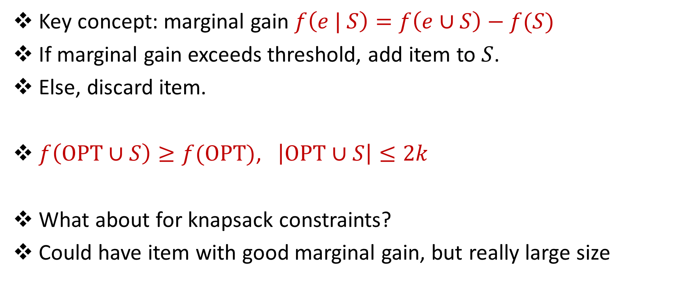
Thresholding in Review
Key concept: marginal gain $f\left(e | S\right)=f\left(e∪S\right)−f(S)$
If marginal gain exceeds threshold, add item to $S$.
Else, discard item.
$f\left(OPT∪S\right)≥f(OPT)$, $\left|OPT∪S\right|≤2k$
What about for knapsack constraints?
Could have item with good marginal gain, but really large size

Slide 21

Knapsack Optimization
Stream:$\}$

Slide 22

Knapsack Optimization
Key concept: marginal density $ρ\left(e | S\right)=\frac{f\left(e∪S\right)−f\left(S\right)}{c(e)}$
If marginal density exceeds threshold, add item to $S$.
Else, discard density. Does it work?

Slide 23

Knapsack Optimization
ALG 1:
If marginal density exceeds threshold, add item to $S$.
Else, discard density.
ALG 2:
Keep “best” element
ALG: Return max(ALG 1, ALG 2)

Slide 24







Adversarial Robust Submodular Optimization

Slide 25

Adversarial Robust Submodular Optimization

Slide 26

Adversarial Robust Submodular Optimization

Slide 27

Adversarial Robust Submodular Optimization

Slide 28

Adversarial Robust Submodular Optimization

Slide 29
Adversarial Robust Submodular Optimization

Slide 30



Adversarial Robust Submodular Optimization

Slide 31
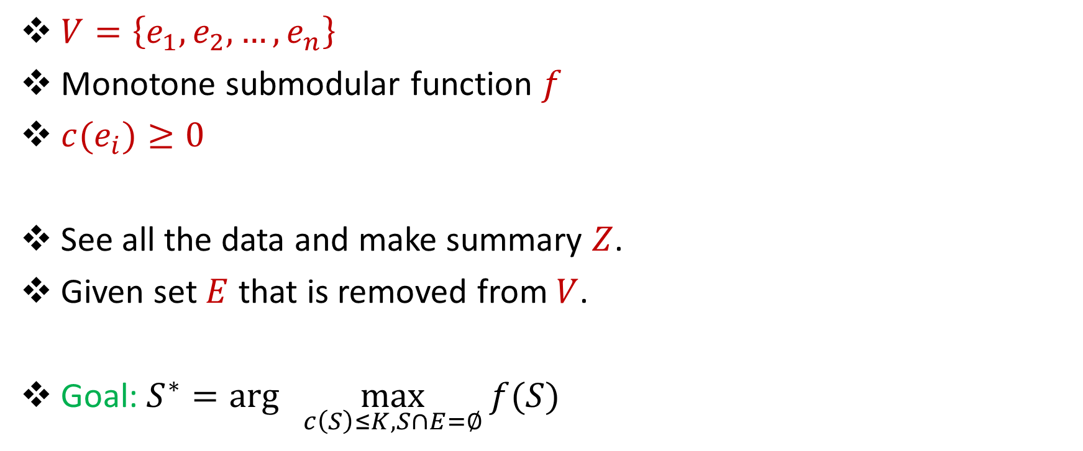
Adversarial Robust Submodular Optimization
$V=\left\{e_{1},e_{2},…,e_{n}\right\}$
Monotone submodular function $f$
${c(e}_{i})≥0$
See all the data and make summary $Z$.
Given set $E$ that is removed from $V$.
Goal: $S^{∗}=arg\max_{ c\left(S\right)≤K, S∩E=∅}{f(S)}$

Slide 32
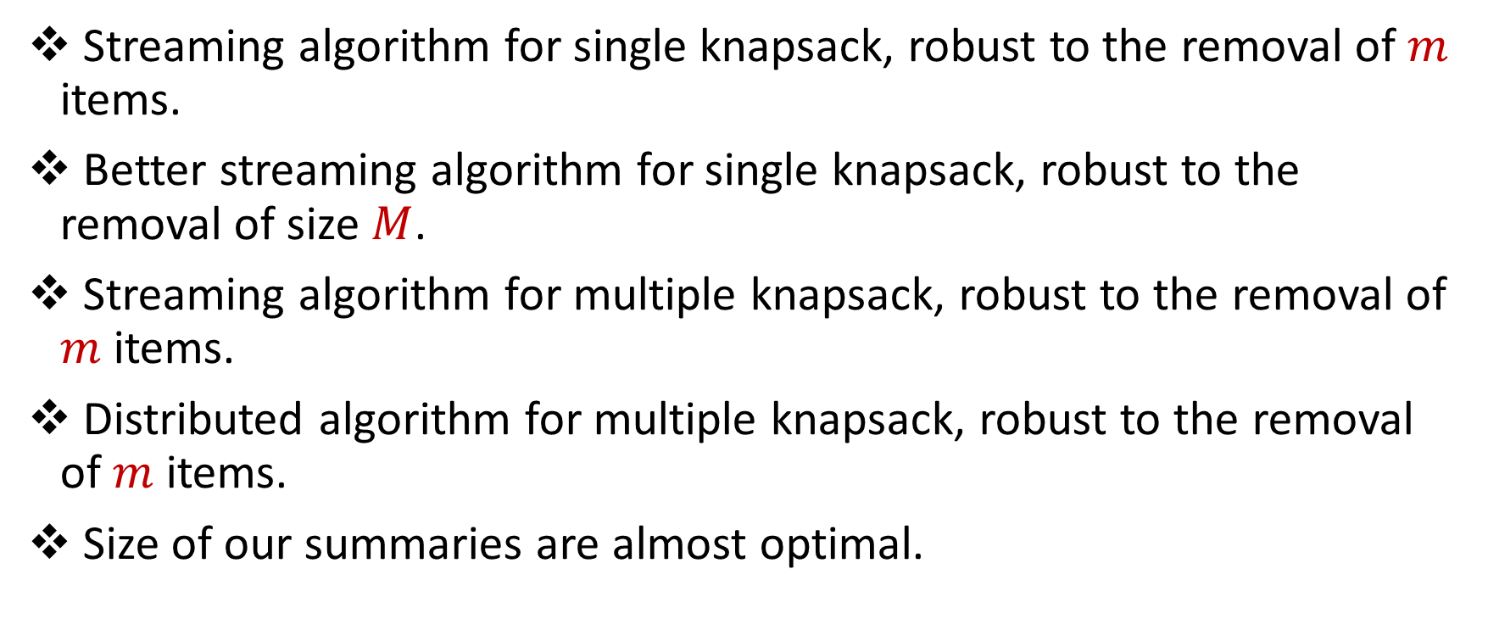
Results
Streaming algorithm for single knapsack, robust to the removal of $m$ items.
Better streaming algorithm for single knapsack, robust to the removal of size $M$.
Streaming algorithm for multiple knapsack, robust to the removal of $m$ items.
Distributed algorithm for multiple knapsack, robust to the removal of $m$ items.
Size of our summaries are almost optimal.

Slide 33
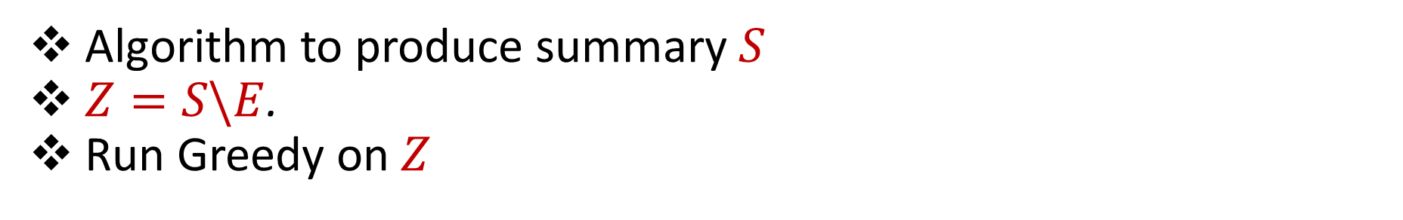
Approach
Stream:
Algorithm to produce summary $S$
$Z=S\backslash E$.
Run Greedy on $Z$

Slide 34




Partitions and Buckets Data Structure [Bogunovic, Mitrovic, Scarlett, and Cevher ‘17]
Partition 3
$$τ$$
Partition 2
$$τ/2$$
Partition 1
$$τ/4$$
$$τ/8$$
Partition 0

Slide 35

Partitions and Buckets Data Structure [Bogunovic, Mitrovic, Scarlett, and Cevher ‘17]
Partition 3
$$τ$$
Partition 2
$$τ/2$$
Partition 1
$$τ/4$$
$$≥^{?}τ$$
$$τ/8$$
Partition 0

Slide 36

Partitions and Buckets Data Structure [Bogunovic, Mitrovic, Scarlett, and Cevher ‘17]
Partition 3
$$τ$$
Partition 2
$$τ/2$$
Partition 1
$$τ/4$$
$$≥^{?}τ/2$$
$$τ/8$$
Partition 0

Slide 37

Partitions and Buckets Data Structure [Bogunovic, Mitrovic, Scarlett, and Cevher ‘17]
Partition 3
$$τ$$
Partition 2
$$τ/2$$
Partition 1
$$τ/4$$
$$≥^{?}τ/4$$
$$τ/8$$
Partition 0

Slide 38
Partitions and Buckets Data Structure [Bogunovic, Mitrovic, Scarlett, and Cevher ‘17]
Items in high partitions are more valuable
Bad approximation if they are deleted, so we need more buckets
Items in low partitions are not as valuable
Still have good approximation if many buckets are full
If many items are deleted from high partitions, but buckets in low partitions are not full, must still have captured “good” items

Slide 39
Towards Knapsack Constraints
Initial idea: replace marginal gain with marginal density
Problem: big items can’t fit
Hotfix: double the size of each bucket
Partition 0

Slide 40
Towards Knapsack Constraints
Problem: number of buckets is based on the threshold, not size
Partition 0
Remains good approximation
Bad approximation!
Partition 0

Slide 41
Towards Knapsack Constraints
Problem: number of buckets is based on the threshold, not size
Main idea: Dynamic bucketing scheme
Each time element is added, allocate space proportional to its size
Cap total number of items
Partition 0

Slide 42
Towards Knapsack Constraints
Items in high partitions are more valuable
Bad approximation if they are deleted, so we need more buckets
Items in low partitions are not as valuable unless they are large
Large items allocate more buckets
Still have good approximation if many buckets are full
If many items are deleted from high partitions, but buckets in low partitions are not full, must still have captured “good” items

Slide 43
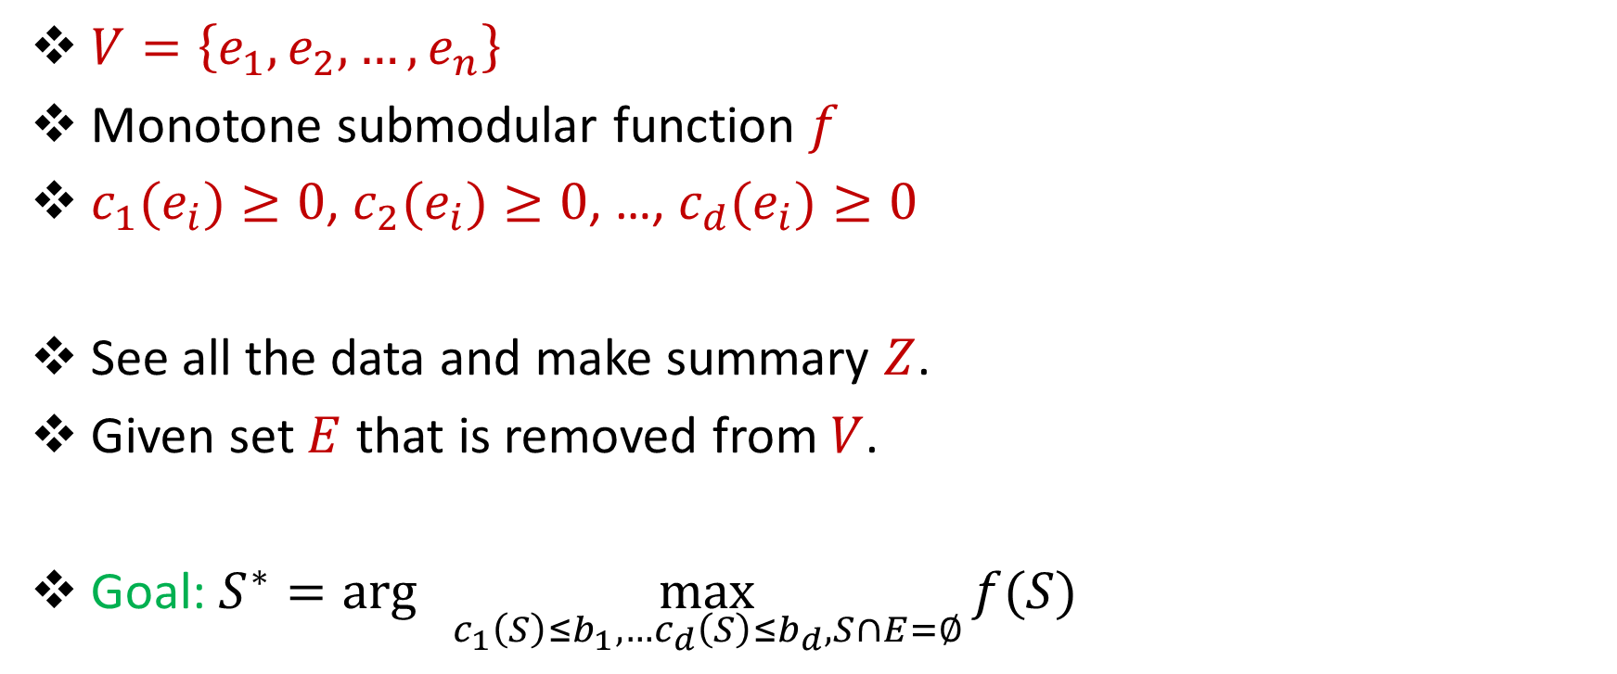
ARMSM: Multiple Knapsacks
$V=\left\{e_{1},e_{2},…,e_{n}\right\}$
Monotone submodular function $f$
${c_{1}(e}_{i})≥0$, ${c_{2}(e}_{i})≥0$, …, ${c_{d}(e}_{i})≥0$
See all the data and make summary $Z$.
Given set $E$ that is removed from $V$.
Goal: $S^{∗}=arg\max_{ c_{1}\left(S\right)≤b_{1},…c_{d}\left(S\right)≤b_{d}, S∩E=∅}{f(S)}$

Slide 44


Normalization
Rescale each row $i$ in cost matrix by $b_{1}/b_{i}$ so that all knapsack constraints are $K≔b_{1}$.
Rescale all entries in cost matrix and constraint vector by minimum entry so that all costs are at least 1.

Slide 45
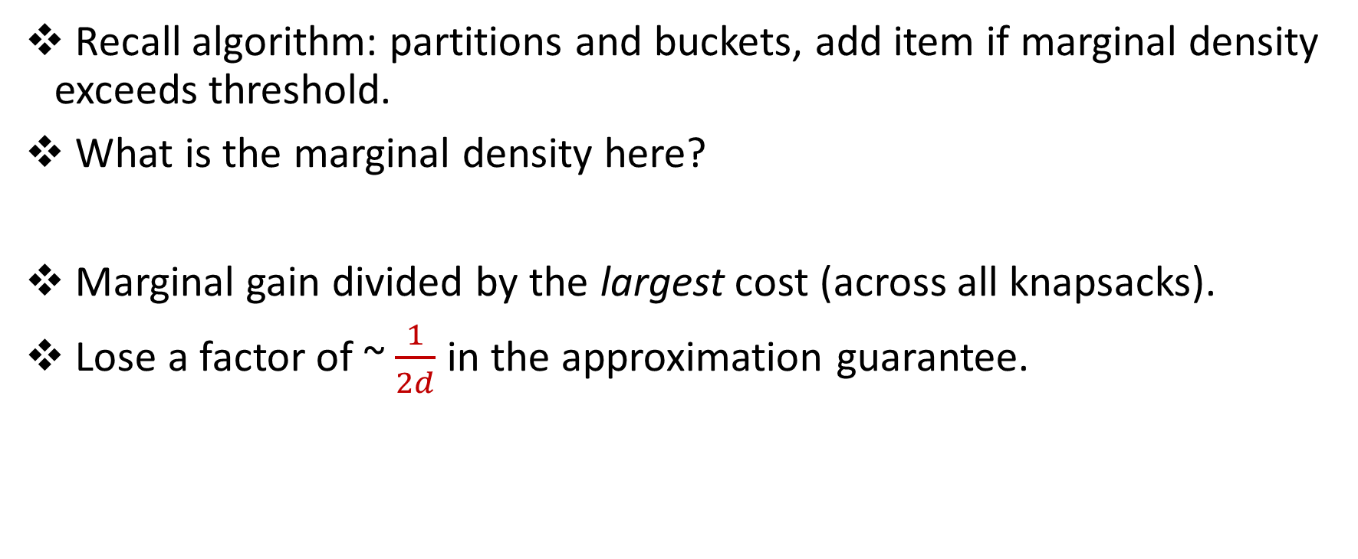
ARMSM: Multiple Knapsacks
Recall algorithm: partitions and buckets, add item if marginal density exceeds threshold.
What is the marginal density here?
Marginal gain divided by the largest cost (across all knapsacks).
Lose a factor of ~ $\frac{1}{2d}$ in the approximation guarantee.

Slide 46
Distributed Algorithm
Send partition and buckets data structure and data across multiple machines
With high probability, “bad” cases will be split across multiple machines

Slide 47
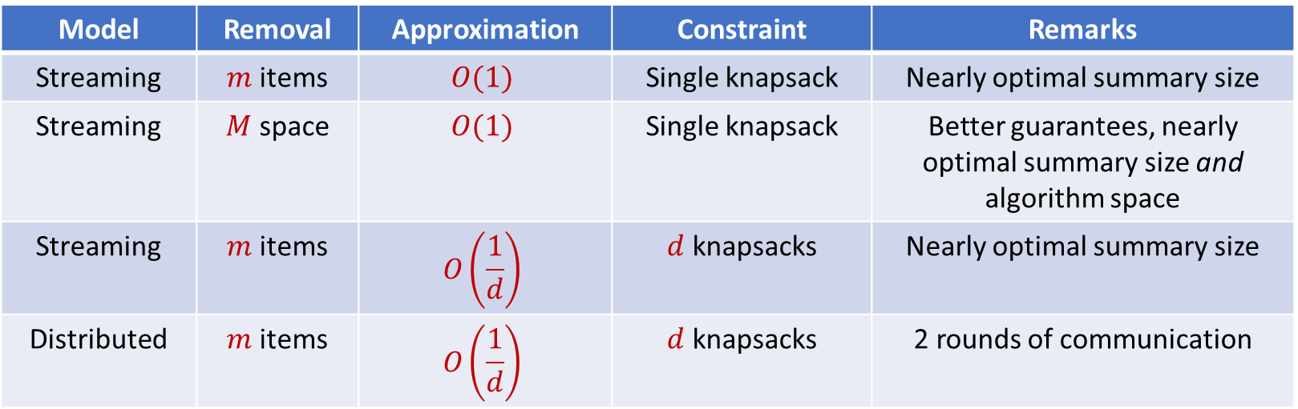
Results
First constant factor approximation algorithms for submodular maximization robust to a number of removals
Model | Removal | Approximation | Constraint | Remarks
Streaming | $m$ items | $$O(1)$$ | Single knapsack | Nearly optimal summary size
Streaming | $M$ space | $$O(1)$$ | Single knapsack | Better guarantees, nearly optimal summary size and algorithm space
Streaming | $m$ items | $$O\left(\frac{1}{d}\right)$$ | $d$ knapsacks | Nearly optimal summary size
Distributed | $m$ items | $$O\left(\frac{1}{d}\right)$$ | $d$ knapsacks | 2 rounds of communication

Slide 48
Empirical Evaluations
Social network graphs from Facebook (4K vertices, 81K edges) and Twitter (88K vertices, 1.8M edges) collected by the Stanford Network Analysis Project (SNAP).
Dominating set
MovieLens (27K movies, 200K ratings)
Coverage
Baselines: Offline Greedy, “Robustified” versions of streaming algorithms

Slide 49
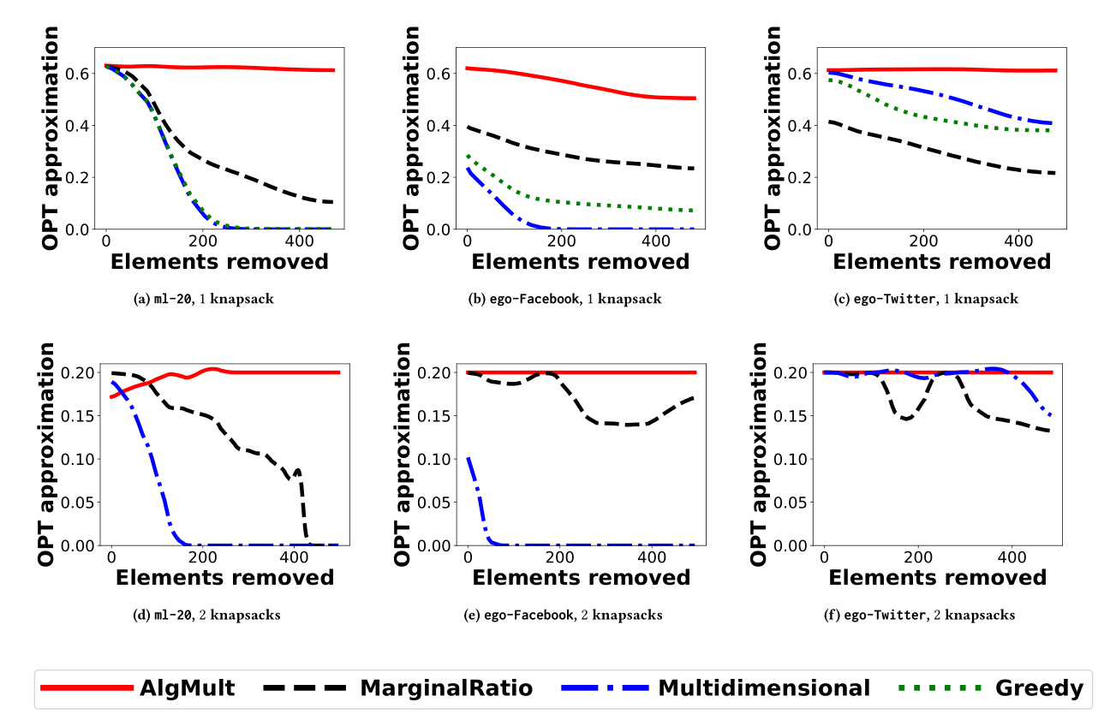
Empirical Evaluations

Slide 50
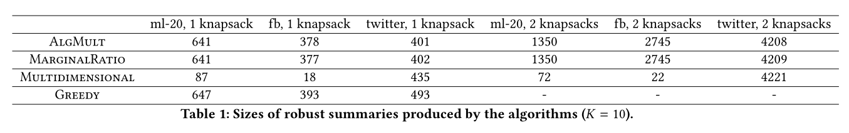
Empirical Evaluations

Slide 51
Related Questions?
Non-monotone robust submodular maximization
Other constraints
Better approximation guarantee
Streaming algorithms with less space

Slide 52
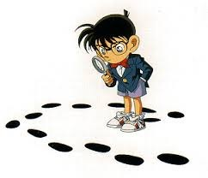

Questions?

